Slide 1

CS441: Lecture 8 The Internet Technologies – Part 1 Introducing the Internet
Ravi Mittal
ravi.mittal@iitgoa.ac.in
Indian Institute of Technology, Goa

Slide 2
Contents
Our lives back then..
The old world of isolated Telecom technologies
Then came the Internet
The magic begins

Slide 3
Our lives back then..

Slide 4
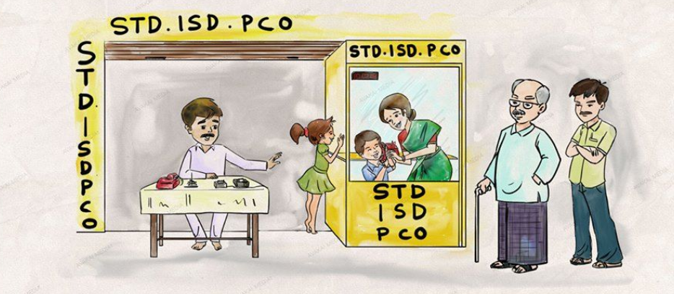
Just about 20 years back!

Slide 5
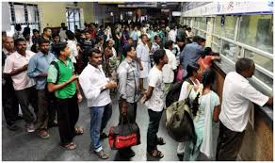
Railway ticket booking office

Slide 6
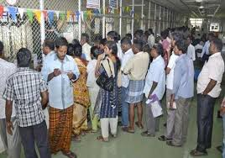
Bijali ka Bill payment

Slide 7
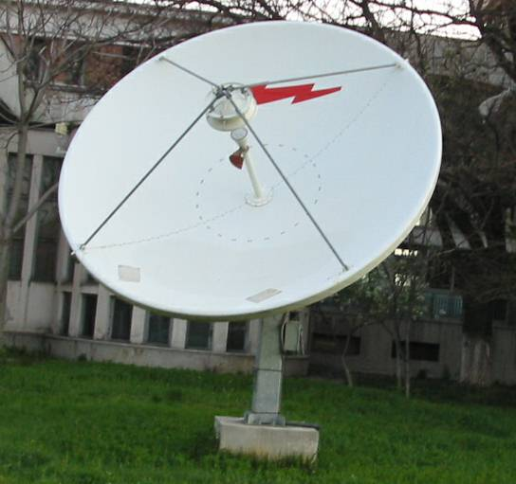
Very few IT companies.. Connectivity was very limited

Slide 8



Availability of few knowledge resources
Late availability of journals
A very few books
No on-demand availability

Slide 9
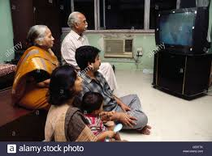
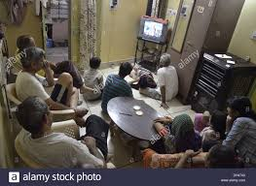
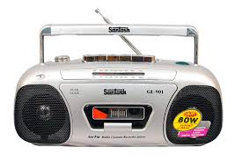
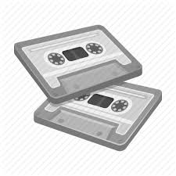
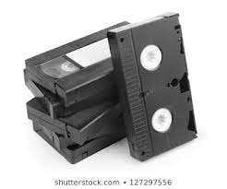
Limited Movies and songs..on TV, tape recorder and player

Slide 10




Letters .… Calling was expensive

Slide 11
Without Internet …
A significant part of life has gone in Queues …
Very low productivity
Extremely expensive personal communication
Plain Old Telephones
Telegrams
Letters
No online money, Bank
Limited availability of Knowledge sources
Very few IT companies
No telecommuting
No Apps on mobile phone

Slide 12
The old World of Isolated Telecom Technologies

Slide 13
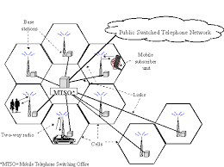
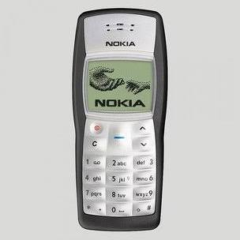
Too many isolated communication technologies

Slide 14
Many (isolated) Communication Technologies and Protocols
PSTN
Frame Relay
PDH/T1/E1
ATM
X.25
Sonet
ISDN
GSM/GPRS
SDH
Ethernet
DSL/ADSL
PSTN/Fax
Token Ring
Cable TV
Token Bus
Microwave
Radio Broadcast
AM, FM
Satellite
SNA

Slide 15
Example: Severe Limitations of Telephones
Previous generation Telecom technologies are designed for one application
Plain Old Telephone networked was over engineered to carry only 4 KHz voice channel
Worked beautifully for over half a century
But, it can’t carry anything apart from voice

Slide 16
Then came the Internet..

Slide 17
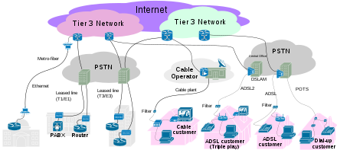
The Internet – to glue different type of Networks

Slide 18
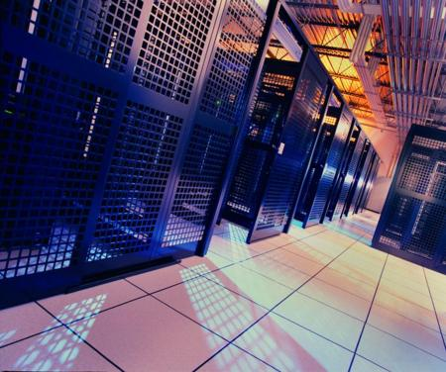
The Internet – to glue different type of Networks
Servers
Top of Rack
Agg. Switches
Mobile Backhaul ,
Base Station
The Internet
IP Routers and Switches
Data Center Network
Mobile Backhaul
Access Network
Metro Ethernet
Core Network
Mobile Network
Fixed Network
Enterprise Network
Workgroup switches
edge routers, connectivity
Broadband
GPON, EPON, DSL,
DSLAMs, CABLE

Slide 19
What does the Internet Provide?
Connectivity to various types of Networks – It is an Interconnect technology
Unique address (identifier) to each communicating station
Routing of Information (Packets)
Filling up of information in Packet (as packet payload)
It carries information consisting of 0s and 1s
These 0s and 1s can represent any type of information
Data
Voice
Video
Etc
Compare this with PSTN Telephone – which can carry only Voice

Slide 20
It’s main characteristics
Extremely Flexible
Can work when bandwidth is low and high .. Kbps – Gbps
Extremely Fault Tolerant
Can work when a part of the network is faulty
Fast recovery from faults
End-to-End Principle
Internet provides almost flat pipe – with absolutely no built-in intelligence
Anything you put at one end appears at the other end
It’s main purpose is to transport bits (inside a packet)
No restriction on application types: millions of applications at the end points
Each application can have it’s own uniqueness

Slide 21
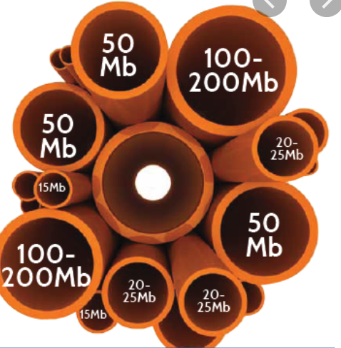
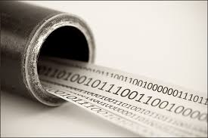
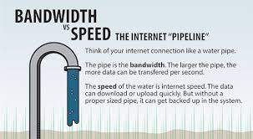
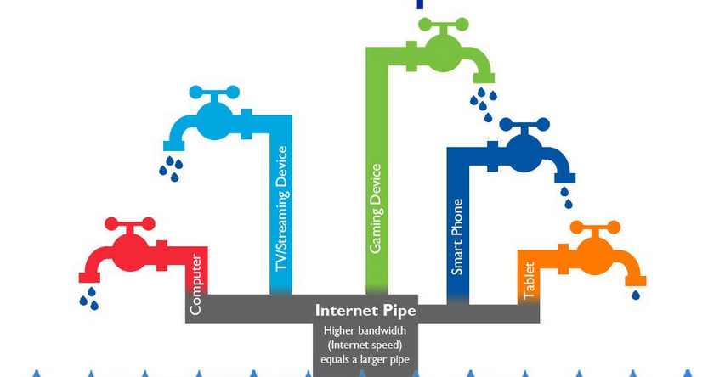
Pipe Analogy

Slide 22
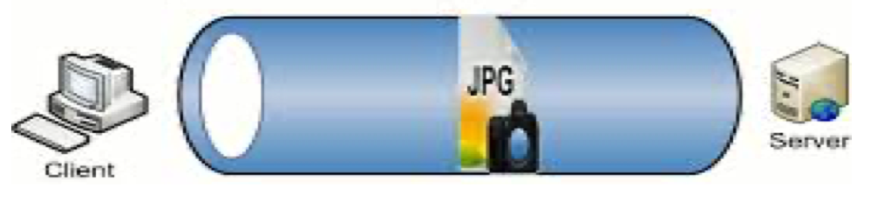
Pipes can carry anything as long as it is fluid (0s and 1s)
At any speed
Any end machine that has IP address and that supports IP protocol suit (IP/TCP/UDP) and associated protocols, can be part of the global Internet
The intelligence lies at the end devices – they decide what to do with bits
Pipe has no intelligence
Get illusion of pipe .. Through transmission of IP packets

Slide 23
The Internet Layering Model
host
host
HTTP message
HTTP
HTTP
TCP segment
TCP
TCP
router
router
IP
IP packet
IP packet
IP packet
IP
IP
IP
Ethernet
interface
Ethernet
interface
SONET
interface
SONET
interface
Ethernet
interface
Ethernet
interface

Slide 24
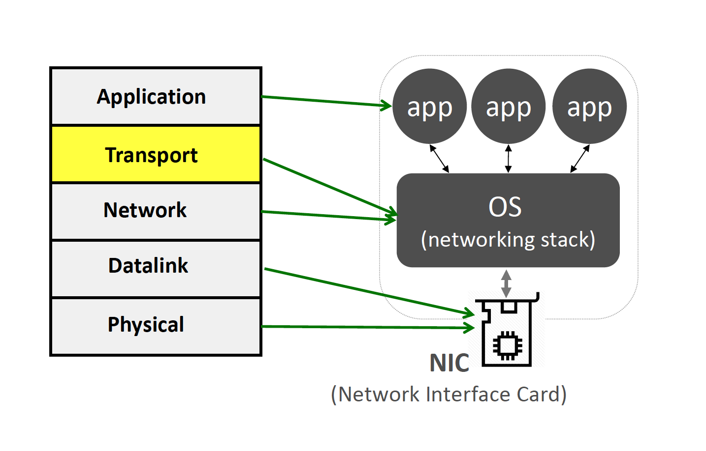
Layered Architecture

Slide 25
IP protocol or IP Network routes IP packets using routers
IP protocol doesn’t provide reliability or security
Reliability and Security is the responsibility of end hosts

Slide 26
Internet Protocol Suite
host
host
HTTP message
HTTP
HTTP
Provides Reliability
TCP segment
TCP
TCP
router
router
IP
IP packet
IP packet
IP packet
IP
IP
IP
Ethernet
interface
Ethernet
interface
SONET
interface
SONET
interface
Ethernet
interface
Ethernet
interface

Slide 27
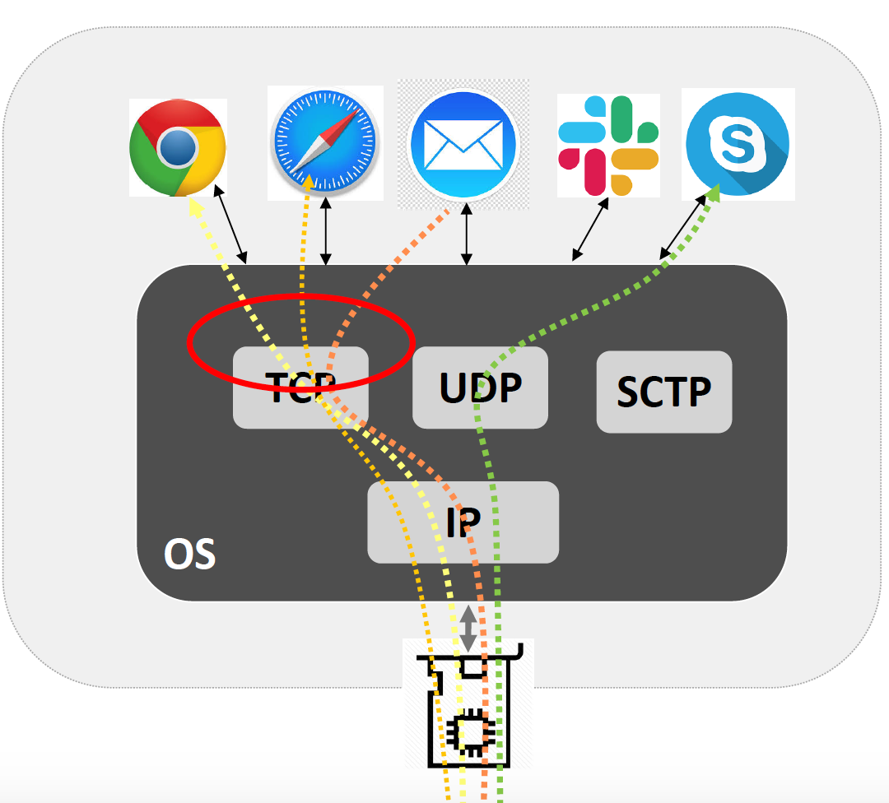
TCP: Demultiplexing
Source: Sylvia Ratnasamy, Course CS 166, Univ of California, Berkeley
Notes:
Stream Control Transmission Protocol
SCTP is message-oriented whereas TCP is stream-oriented

Slide 28

Distributed mechanism of Internet
link
end-system
switch
path
packet
Source: Prof Scott Shenker – Univ of Berkeley at California

Slide 29
Internet Routing and forwarding
routing algorithm
routing algorithm determines
end-end-path through network
local forwarding table
forwarding table determines
local forwarding at this router
header value
output link
0100
0101
0111
1001
3
2
2
1
value in arriving
packet’s header
0111
1
3
2
Routing Protocols:
OSPF, BGP, IS-IS
Book: Kurose and Ross

Slide 30
IPv4 Packet format
IP protocol version
number
32 bits
total datagram
length (bytes)
header length
(bytes)
head.
len
type of
service
ver
length
for
fragmentation/
reassembly
“type” of data
flgs
fragment
offset
16-bit identifier
max number
remaining hops
(decremented at
each router)
time to
live
upper
layer
header
checksum
32 bit source IP address
upper layer protocol
to deliver payload to
32 bit destination IP address
options (if any)
e.g. timestamp,
record route
taken, specify
list of routers
to visit.
data
(variable length,
typically a TCP
or UDP segment)
how much overhead?
20 bytes of TCP
20 bytes of IP
= 40 bytes + app layer overhead
Book: Kurose and Ross

Slide 31
Now, the magic begins with the Internet !

Slide 32
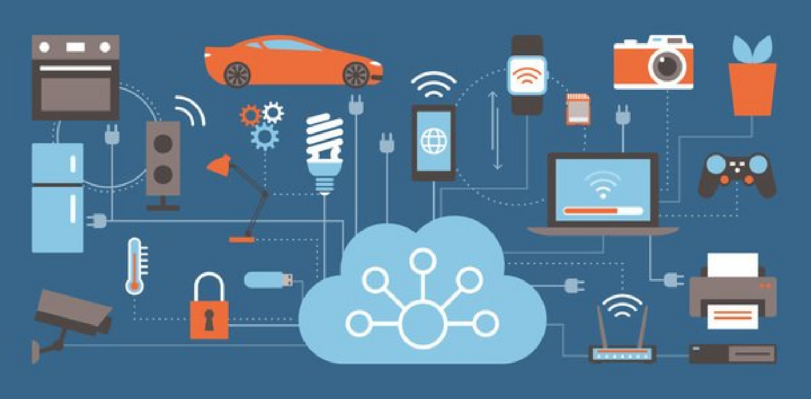
Now it’s Hyper connected World
You can connect to any device over any network – as long as
It supports the Internet

Slide 33
It can carry data for any application! and Any application can be coded in terms of 0s and 1s
WoW! The Internet

Slide 34

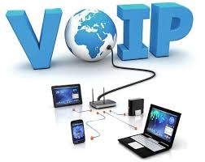
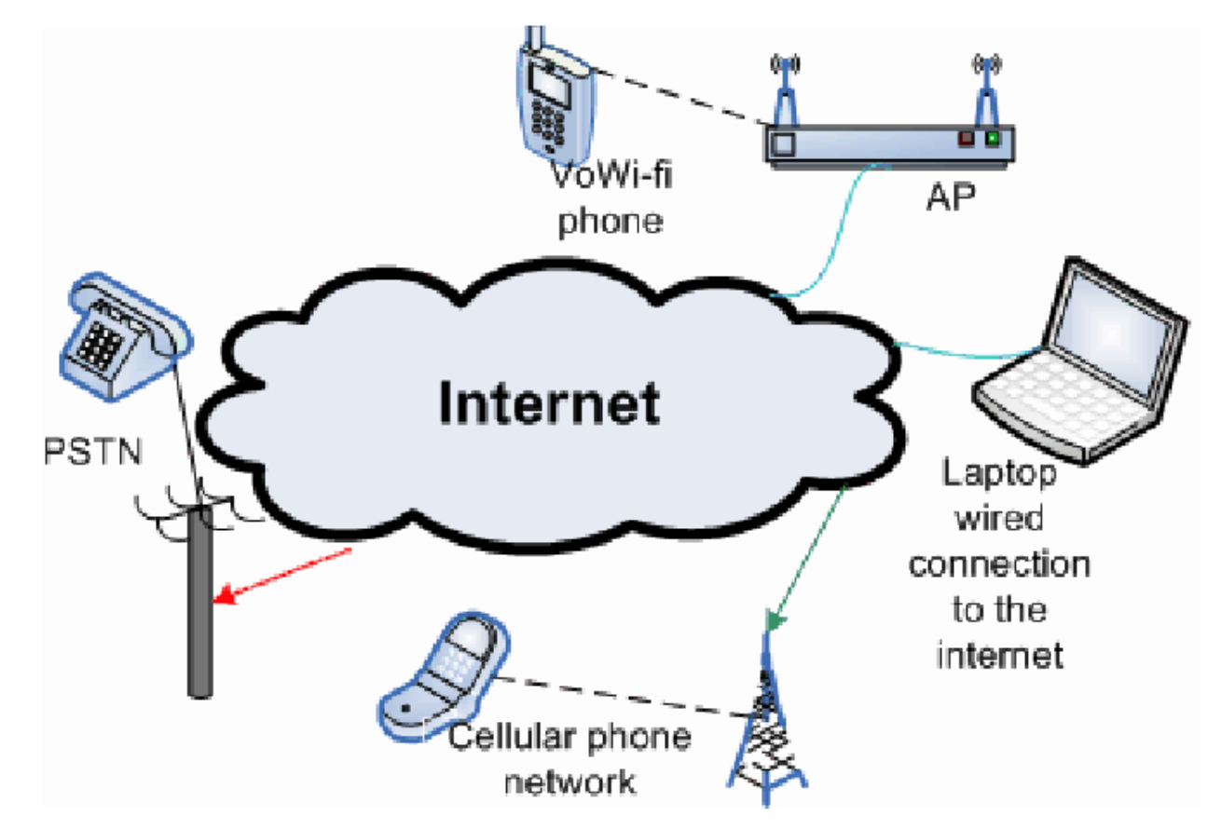
Voice over IP

Slide 35
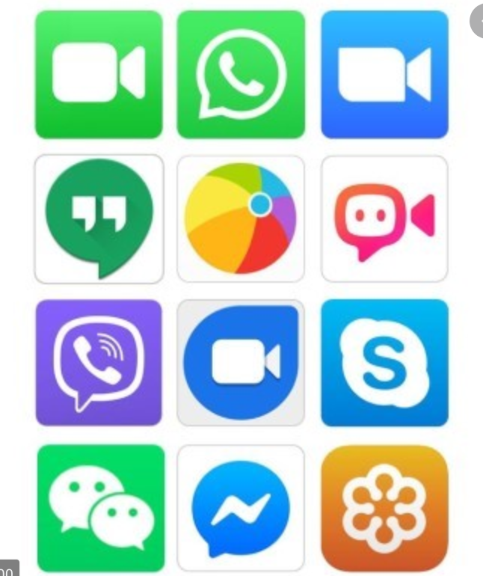
Video Conferencing over IP

Slide 36
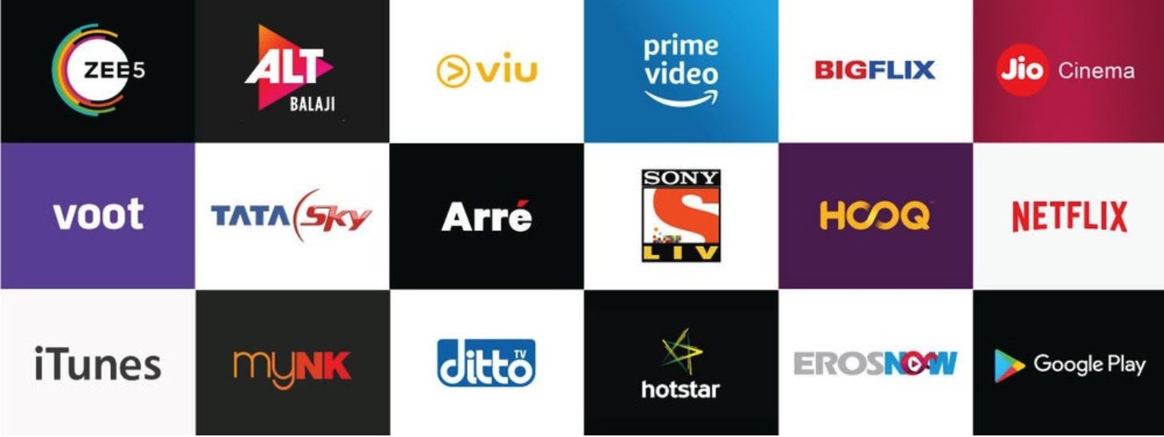
Over the Top Platform (OTT) Apps – over the Internet
An over-the-top (OTT) media service is a streaming media service offered directly to viewers via the Internet – bypassing cable, broadcast, and satellite television platforms

Slide 37
Mobile Phones use Internet
Almost all applications on mobile handset use the Internet for communication
Internet connection on Mobile
Using cellular network
WiFi
Without Internet on smart mobile phone
It becomes old feature phone – only for voice calling and SMS
With Internet, mobile phone becomes
A powerful computer – that supports millions of applications
Mobile (Smart) phones are available everywhere – Internet is available everywhere → Users can run million of applications

Slide 38
Lecture Summary
The Internet has changed the world of communication – Telecommunication
It is available in every part of the world – It reaches to over 59% of world population
It is an interconnect technology – It can be carried over a large number of existing communication technologies
It is a packet based technology
Packets can carry any information/content that can be digitized
Extreme flexibility – can run over diverse conditions – low bandwidth, high packet drops etc
It forms the core of digital transformation

Slide 39
Backup Slides

Slide 40
The Internet is very important for us!
…has changed computer science
…has changed our lives
…has made the world flat
…helped us tremendously to gain employment (IT Industry)
…There has never been such a powerful Telecom technology
…Every device is getting connected to it
…Its very simple technology
…it will remain in existence for many decades
…lastly, it is very important for you to learn it as an engineer … as it will touch all domains of your work and study

Slide 41
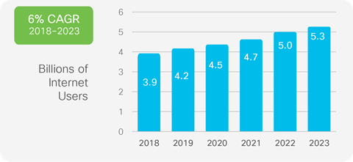
Growth of Internet Users
66 percent of global population penetration by 2023
Source: Cisco Annual Internet Report, 2018-2023

Slide 42
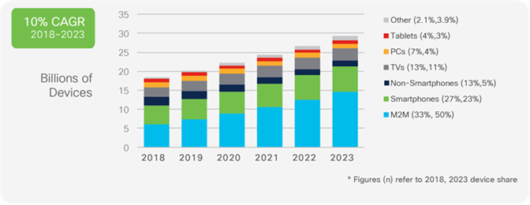
Devices and Connection Growth
Machine-to-Machine communication (Internet) will grow at the fastest pace
Source: Cisco Annual Internet Report, 2018-2023

